Slide 1
5G Power Domain NOMA Systems

Slide 2
Roadmap
Encoding
Transmission
Demodulation
Decoding
Quality Check
The data to be transmitted is encoded into a digital bitstream using techniques such as modulation, channel coding, and error correction coding.
The encoded bitstream is transmitted
using wireless communication techniques such as NOMA.
The received signal is demodulated to recover the original digital bitstream.
The decoded bitstream is then processed using error correction decoding techniques to correct any errors that may have occurred during transmission.
The decoded data is then checked for its Quality of Service (QoS) and Quality of Experience (QoE) parameters to ensure that it meets the required performance metrics.

Slide 3
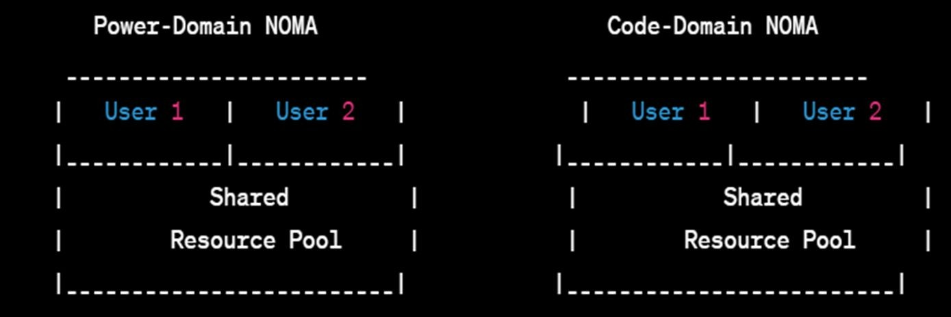
Introduction
5G?
5G networks are expected to revolutionize a wide range of industries, from healthcare to transportation to entertainment, by enabling real-time,
high-bandwidth applications such as remote surgeries, autonomous vehicles, and virtual reality experiences.
NOMA?
NOMA stands for Non-Orthogonal Multiple Access. It is a wireless communication technique that allows multiple users to share the same frequency and time resources to transmit their data simultaneously.

Slide 4
Objective
To evaluate different methods for converting audio, text, video, and image data into binary format that is compatible with 5G power systems, and to investigate the impact of these methods on the quality of experience (QoE) of the received data.
The project aims to identify the most efficient and effective method for binary conversion that can optimize the performance of 5G networks and enhance the user experience for different types of data traffic.
This objective focuses on the evaluation of binary conversion methods and their impact on QoE, which aligns with the problem statement you provided.

Slide 5
Encoding categories of services.
Sampling: The analog signal is sampled at regular intervals.
Quantization: The numerical values obtained from sampling are quantized
Compression: To reduce the amount of data required to represent the digital signal, compression techniques such as lossy and lossless compression are applied.
Encoding: The compressed digital signal is then encoded into a bitstream.

Slide 6
Voice coder (Vocoder)
The basic principle of a vocoder is to analyze the spectral characteristics of a human voice and then use this information to synthesize a new signal with the same spectral properties.
The synthesized signal is then combined with other audio signals or used to modulate a carrier signal for transmission over a telecommunications network.
To encode the spectral characteristics of a voice signal, a vocoder typically uses a technique called linear predictive coding (LPC).
At the receiver end, the encoded control parameters are decoded and used to reconstruct the original voice signal

Slide 7
Synthesis modelling
Synthesis modeling is a technique used in digital signal processing to create a complex signal by combining multiple simpler signals.
The process of synthesis modeling typically involves choosing a set of basis functions that can be used to represent the complex signal.
Once the basis functions have been selected, the synthesis model generates the new signal by adding together scaled versions of each basis function.
Synthesis modeling is used in a variety of signal processing applications, including sound synthesis, image processing, and video compression.

Slide 8
Service Specific Generation
Service-specific generation refers to the ability of the network to create and support specific services that are tailored to the needs of different types of applications and users.
The 5G network architecture includes a Service-Based Architecture (SBA),
which is designed to support service-specific generation.
The SBA is based on a set of service-based interfaces that enable communication between network functions and allow services to be dynamically created and managed.
Overall, service-specific generation in 5G networks enables the creation and delivery of services that are tailored to the needs of specific applications and users

Slide 9
Service Specific Traffic
Service-specific traffic in 5G networks refers to the traffic generated by specific applications or services that have different requirements in terms of quality of service (QoS), throughput, latency, and reliability.
5G networks are designed to support service-specific traffic by providing different network capabilities and features that can be tailored to the requirements of different services.
By using network slicing, the network can allocate resources, prioritize traffic, and apply specific policies and QoS parameters to each slice, based on the requirements of the specific service or application.
Overall, service-specific traffic is an important aspect of 5G networks, as it allows for the creation and delivery of customized services that can meet the specific needs and requirements of different applications and users.

Slide 10
Increasing Channel capacity
Superposition coding is a technique used in wireless communication systems to increase the capacity of the system.
It allows multiple data streams to be transmitted over the same radio frequency channel at the same time, by adding the signals together.
Successive interference cancellation (SIC) is a technique used in wireless communication systems to improve the performance of multiple-access communication channels.
It is a type of interference management strategy that allows multiple users to share the same frequency band by canceling out the interference caused by other users.

Slide 11
Recovery Modelling
Recovery modeling is a technique used in digital signal processing to decompose a signal into its constituent components.
It involves analyzing a signal to determine the individual components that make up the signal.
Once the individual components of the signal have been identified, they can be processed independently using techniques such as filtering, compression, or enhancement.
Recovery modeling is used in a variety of signal processing applications, including compression, noise reduction, and filtering.

Slide 12
QOE
Mean Opinion Score (MOS): MOS = 1 + (0.035 x R) + (0.000007 x R x (R-60) x (100-R)), where R is the overall rating of the quality of experience, with a scale from 0 to 100.
Video Quality: VQ = (PSNR - PSNRmin) / (PSNRmax - PSNRmin), where PSNR is the Peak Signal-to-Noise Ratio of the video
Voice Quality: VQ = (MOS - MOSmin) / (MOSmax - MOSmin), where MOS is the Mean Opinion Score of the voice quality.
Web Browsing Quality: WBQ = (Page Load Time - PLTmin) / (PLTmax - PLTmin), where PLT is the Page Load Time of a website

Slide 13
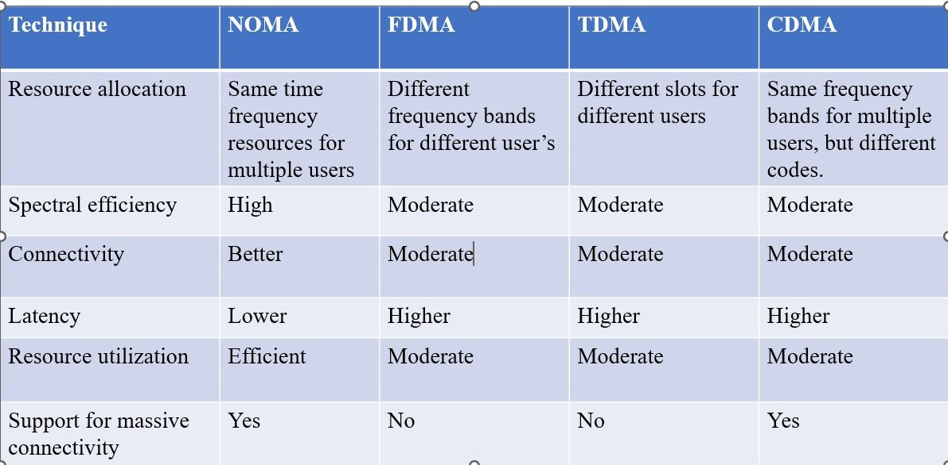
Limitations in existing technology

Slide 14
Proposed Solution
Research and evaluate different methods for converting audio, text, video, and image data into binary format that are compatible with 5G power systems.
Develop a software module to implement the selected binary conversion method(s) and integrate it with the 5G network architecture.
Conduct experiments to evaluate the performance of the binary conversion module in terms of throughput, latency, QoS, and QoE and identify the most efficient and effective method(s) for binary conversion that can optimize the performance of 5G networks and enhance the user experience for different types of data traffic.

Slide 15
Thank you

